Slide 1
Presentation on my study project progress
„Does a re-infection of Eimeria lead to a down regulation of the Th1 immune reaction in Mus musculus“
Notes:
study focuses on host/parasite interaction > house mouse and endoparasite Eimeria
verifying previous studies by conducting the similar experiment and gather more datasets

Slide 2
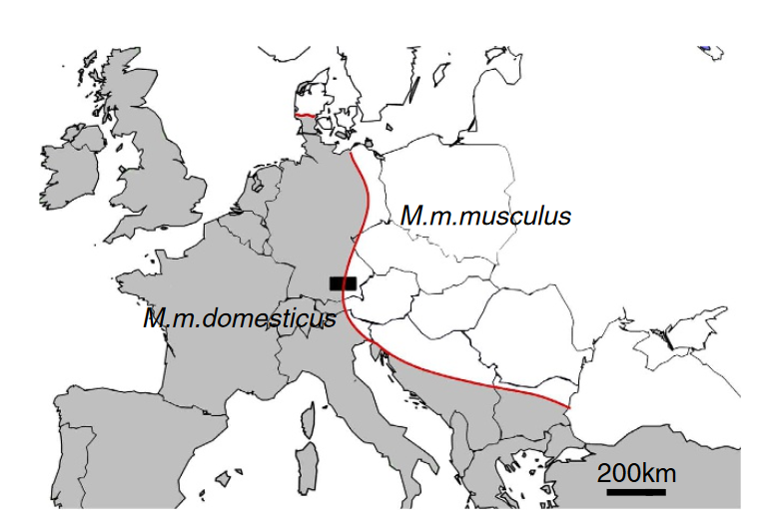
The Host and the House Mouse Hybrid Zone (HMHZ)
Mus musculus well researched
Radiation 0,5 MYA into subspecies domesticus, musculus and castaneus
Hybrid Zone: subspecies interbreed
Wang J et al. 2014
Notes:
house mouse is one most researched and well known mammal due to easy handling and short reproductive cycle > suited for laboratory work
latest genus in the phylogentic tree of the mouse is the house mouse Mus musculus and it‘s 3 subspecies Mus musculus musculus (east mouse), Mus musculus domesticus (west mouse) and Mus musculus castaneus (asian mouse)
radiated appr. 0,5 million years ago in the north of Indian subcontinent
different colonization paths > musculus eastern pathway north of black sea / domesticus through middle east and Mediterranean into western Europe / domesticus from the eastern part of the Indian subcontinent to southeastern Asia
distribution due to commensalism with human migration
Zones where different subspecies meet and interbreed called Hybrid Zones > musculus and domesticus in Europe: Denmark (Jutland), Germany (Brandenburg, Munich), Czechia, Bulgaria
30 to 40 km Transition Zone (clines of allele frequencies)

Slide 3
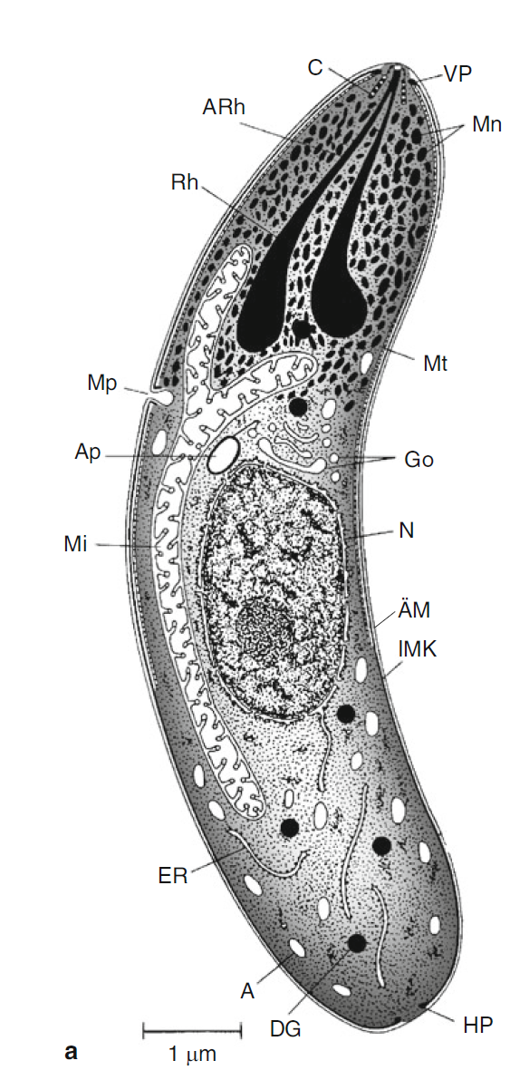
The Parasite - Eimeria
belongs to the Apicomplexa
Important parasite in livestock
do not infect humans
causes coccidiosis
mouse parasites E.falciformis and E.ferrisi
Lucius R, Loos-Frank B, Lane RP,. Biologie von Parasiten 3. Auflage. Springer-Verlag GmbH Deutschland (2018) p. 171
Notes:
characteristics: apical complex (polring, micronemes, rhoptrien, conoid, granula monoxenous (Eimeria) very host and tissue specific cell invasion through gliding motility life-cycle (schizogony, merogony, sporogony) infect epethelial cells of the caecum and upper colon (sometimes schizonts in jejenum and several in ileum)
infects livestock (bovis – cattle ; tenella – poultry) and rodents (for us relevant ferrisi and falciformis > Mus musculus)
causes coccidiosis: hemorrhagic diarrhea, reduced food and water uptake, lethargy and death

Slide 4
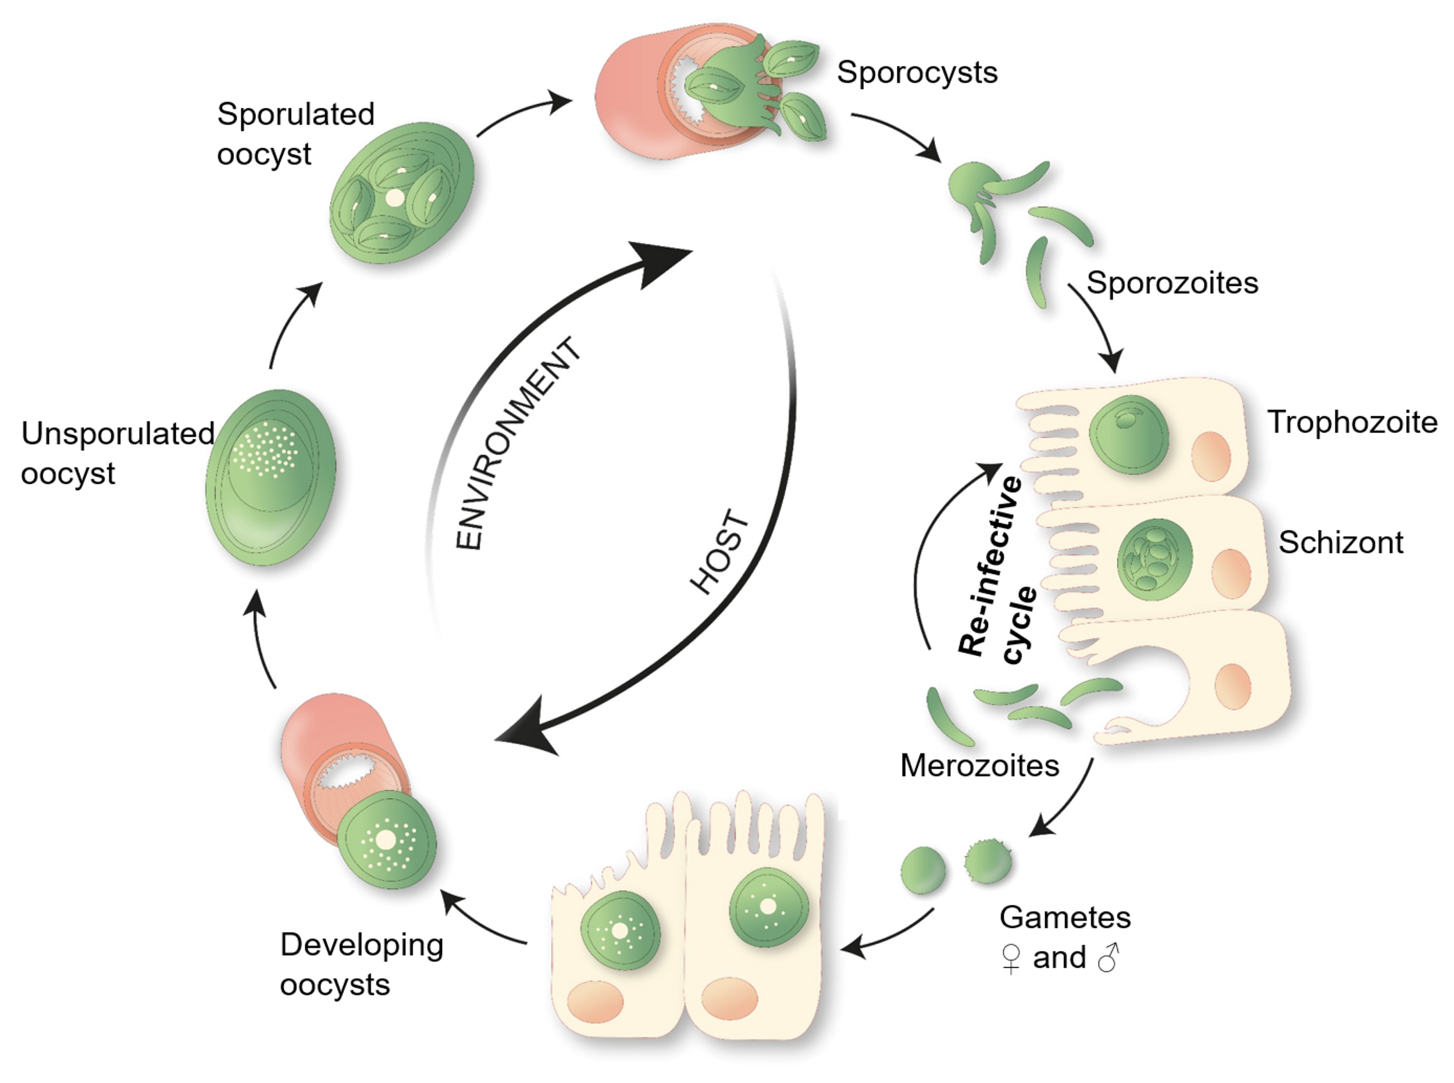
The Life Cycle of Eimeria
Figueiredo-Campos et al. 2018
Notes:
life cycle concsists of 3 steps schizogony 4 sporocysts hatch from orally ingested oocysts > each releases 2 sporozoites > invade murine caecum epithelium develop into shizonts > many merozoits released from infected cell several re-infection cycles befeore differentiation into male and female gametes gamogony m./f. gametes > gametocytes > fuse and form a zygote > develops into unsporulated oocyst and shed with feces sporogony unsporulated oocyst > sporulated oocyst (contains 4 sporocysts with 2 sporozoites each) ingestion starts new cycle

Slide 5
Methodology
RNA Extraction
cDNA Conversion

Slide 6
RNA Extraction using PureLink™ RNA Mini Kit
Homogenization of the sample
Lsysis and binding to filter in spin cartridge
Centrifugation and washing steps
Release of the RNA from the filter and collection of the sample
Photometric measurement of nucleic acid conc. and storage
Notes:
Homogenization
sample + liquid Nitrogen in mortar and pestle to powder > half into tube , half back for later use in ELISA
RNA Extraction
1. 700 μL Lysisbuffer + 1% beta-mercaptoethanol > Vortexen
2. add 700 μL 70 % Ethanol > Vortexen
3. transfer up to 700 μL of the sample to a spin cartridge with collection tube
4. centrifuge at 12.000 x g for 30 s at room temp.; Discard flow-through; Reinsert spin cartridge into same collection tube ; repeat step 3-4
5. Add 700 μL Wash Buffer I
6. Centrifuge at 12.000 x g for 30 s; Discard flow-through ; Reinsert spin cartridge into new collection tube
7. Add 500 μL Wash Buffer II with ethanol
8. Centrifuge at 12.000 x g for 30 s; ; Discard flow-through; Reinsert spin cartridge into same collection tube; repeat 7-8
9. Centrifuge at 12.000 x g for 2 min to dry the membrane with boun RNA, Discard flow-through ; Reinsert spin cartridge into new recovery tube
10. Add 50 μL RNase free water to the center of the spin cartridge
11. Incubate for 1 min
12. Centrifuge at 12.000 x g for 2 min, repeat with reinserted sample
13. store sample at -80°C
Quality and quantity of isolated RNA was measured spectrophotometrically in a NanoDrop 2000c (Thermo Scientific, Waltham, USA).
Kit from ThermoFisher Scientific

Slide 7
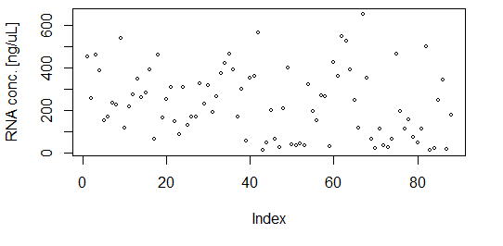
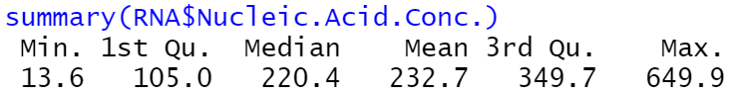
Results RNA extraction

Slide 8
cDNA Conversion using iScript™ cDNA Synthesis Kit
Component | Volume [μL]
5x iScript Reaction Mix | 4
iScript Reverse Transcriptase | 1
Nuclease free water | variable
RNA template (1 μg) | variable
total | 20
Reaction Protocol
Priming | 5 min at 25°C
Reverse transcription | 20 min at 46°C
RT inactivation | 1 min at 95°C
Optional | Cool down at 4°C
Photometric measurement of nucleic acid conc.

Slide 9
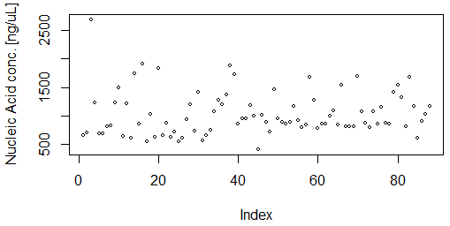
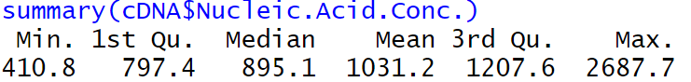
Results cDNA conversion

Slide 10
References
P. Boursot, J.-C. Auffray, J. Britton-Davidian, F. Bonhomme. The evolution of house mice. Annu. Rev. Ecol. Systemat., 24 (2003), pp. 119-152
Guenet, J. L. & Bonhomme, F. Wild mice: an ever-increasing contribution to a popular mammalian model. Trends Genet.19,24–31 (2003)
Lucius R, Loos-Frank B, Lane RP,. Biologie von Parasiten 3. Auflage. Springer-Verlag GmbH Deutschland (2018) pp. 185-189
E. Al-khlifeh, A. Balard, V.H. Jarquín-Díaz, A. Weyrich, G. Wibbelt, E. Heitlinger. Eimeria falciformis BayerHaberkorn1970 and novel wild derived isolates from house mice : differences in parasite lifecycle , pathogenicity and host immune reactions. bioRxiv (2019), pp. 1-33
A. Haberkorn. Die Entwicklung von Eimeria falciformis (Eimer 1870) in der weissen Maus (Mus musculus) Z. für Parasitenkd., 34 (1970), pp. 49-67

Slide 11
Wang J, Kaylan S, Steck N, Turner LM, Harr B, Künzel S, Vallier M, Häsler R, Franke A Oberg HH, Ibrahim SM, Grassl GA, Kebelitz D, and Baines JF. Analysis of intestinal microbiota in hybrid house mice reveals evolutionary divergence in vertebrate hologenome. Nature Communications, (6:6440), Jul 2014. DOI: 10.1038/ncomms7440
Figueiredo-Campos, P., Ferreira, C., Blankenhaus, B. and Veldhoen, M. (2018). Eimeria vermiformis Infection Model of Murine Small Intestine. Bio-protocol 8(24): e3122.

